Slide 1
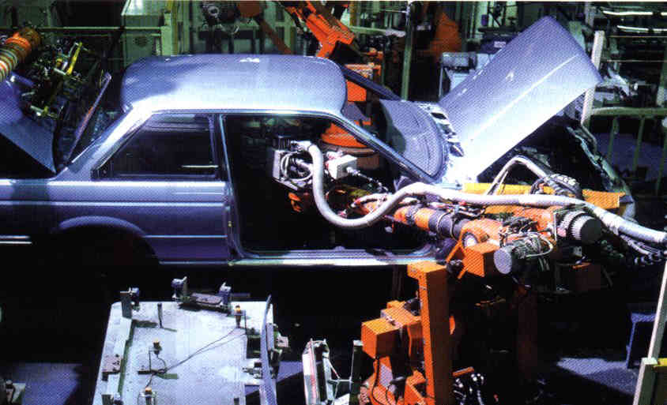

Mechanical Engineering!

Slide 2
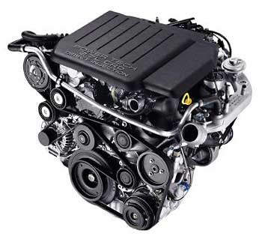
What is mechanical engineering?
The branch of engineering dealing with machines.

Slide 3
What all does mechanical engineers do?
Engineers solve complex problems for society. Mechanical engineers create and build mechanical devices. They apply the fundamentals of science and math to create practical, useful solutions that the rest of us can use.

Slide 4

How much does mechanical engineers get paid?
They earn an average of 90,000 a year.

